Slide 1

Innolux Paper Explaination
with ChatGPT
NYCU MLLAB
Web_paper
Nycu MLlab
Version: 3.8

Slide 2
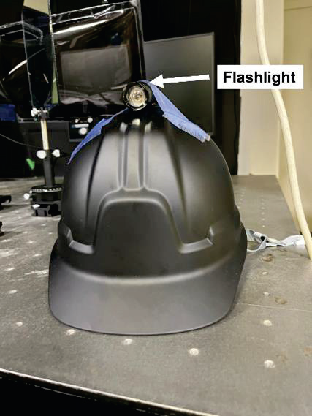
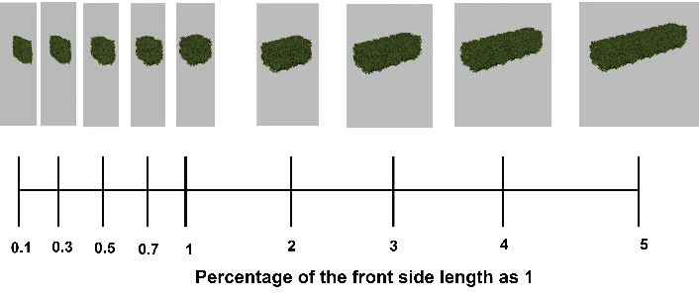
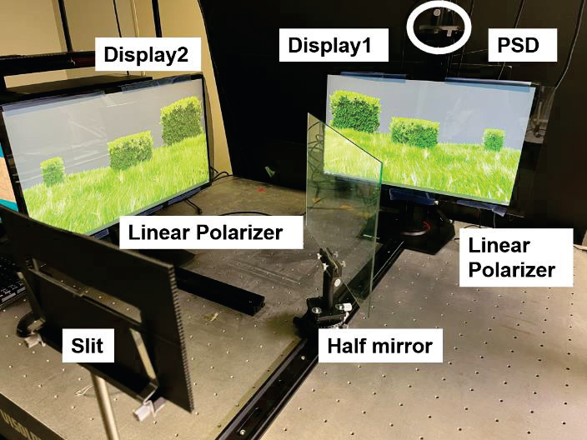
Effects of Motion Parallax Smoothness and Head Moving Range on Reduction of The Cardboard Effect
Kosuke Takahashi,Haruki Mizushina,Shiro Suyama,Kenji Yamamoto Dept. of Optical Science and Technology, Tokushima University, Japan,Center for Optical Research and Education, Utsunomiya University, Japan
Keywords : 3D,cardboard effect,motion parallax,binocular disparity,multiple cameras,Kosuke Takahashi,Dept. of Optical Science and Technology, Tokushima University, Japan Organization: Dept. of Optical Science and Technology, Tokushima University, Japan,Center for Optical Research and Education, Utsunomiya University, Japan
Keypoints : - Smoother motion parallax and wider head movements reduce the cardboard effect in binocular stereoscopic display - Adding motion parallax helps reduce the perceptual distortion known as the cardboard effect - Experiment evaluated effects of motion parallax smoothness and head moving range on reducing the cardboard effect - Results showed that smoother motion parallax and wider head moving range contribute to reducing the cardboard effect - Significant effect observed among different conditions for both subjects in the evaluation
Nycu MLlab

Slide 3
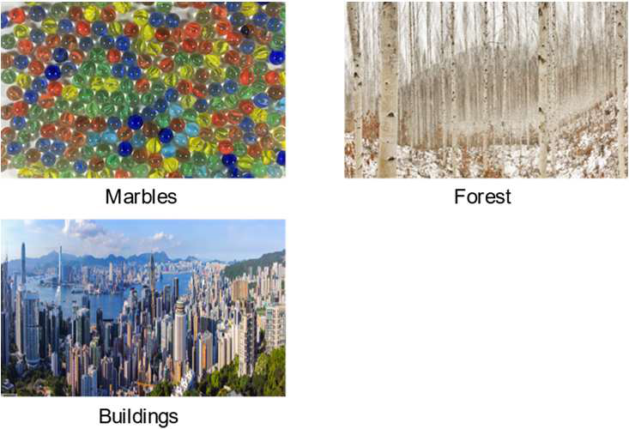
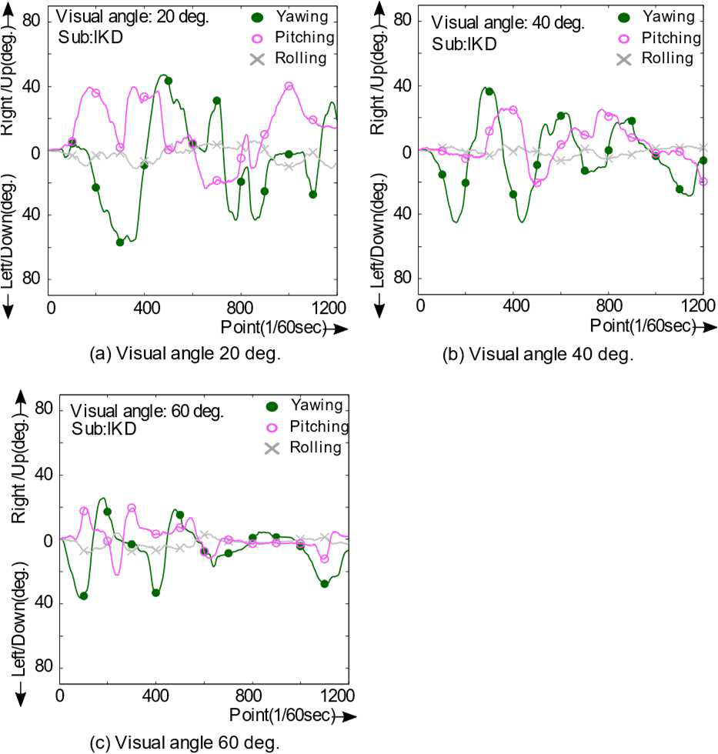
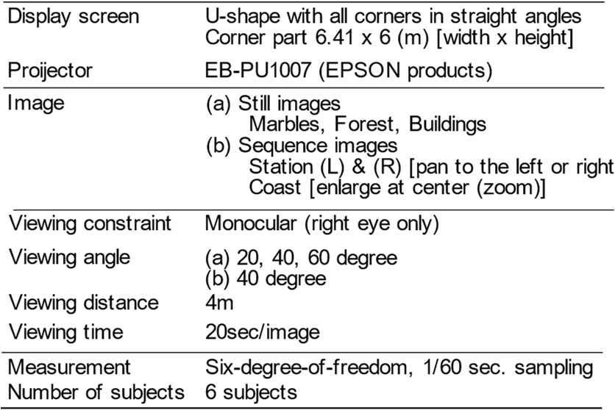
Relationship between Field of View Size and Head Motion in Eyepiece Displays
Sumio YANO,Shuichi OJIMA 1. Shimane University, Japan,2. RITECS Inc, Japan,3. Sojo University, Japan
Keywords : Eyepiece display,Field of view,Head motion,Yawing,Saliency map,Sumio YANO,1. Shimane University, Japan Organization: 1. Shimane University, Japan,2. RITECS Inc, Japan,3. Sojo University, Japan
Keypoints : - Head movements are narrower in a wide field of view - Head movement speed may depend on the frequency component of the image - Images displayed on a U-shaped screen for the experiment - Head movements mainly analyzed in terms of yawing - Saliency maps calculated for still images
Nycu MLlab

Slide 4
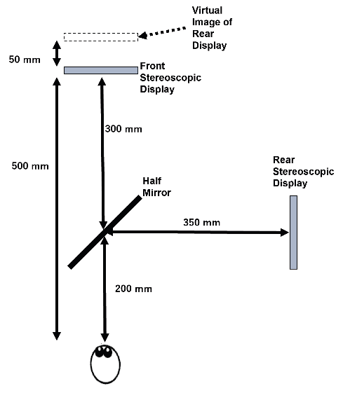
Multi-view DFD (Depth-fused 3D) Rendering with Linear Blending
Yuto Morishita,Munekazu Date,Haruki Mizushina,Shiro Suyama,Kenji Yamamoto Dept. of Optical Science and Technology, Tokushima University, Japan,Faculty of Science and Engineering, Tokushima Bunri University, Japan
Keywords : Multiview display,Stereoscopic display,Linear blending,Depth-fused 3D rendering,Camera distance,Yuto Morishita,Dept. of Optical Science and Technology, Tokushima University, Japan Organization: Dept. of Optical Science and Technology, Tokushima University, Japan,Faculty of Science and Engineering, Tokushima Bunri University, Japan
Keypoints : - Development of Multi-view DFD rendering with linear blending - Reduction of cameras in stacked multi-view displays - Evaluation of depth of 3D images at different camera distances - Introduction of Multi-view DFD combined with stereo display - Demonstration of smoother images in stacked multi-view displays
Nycu MLlab

Slide 5
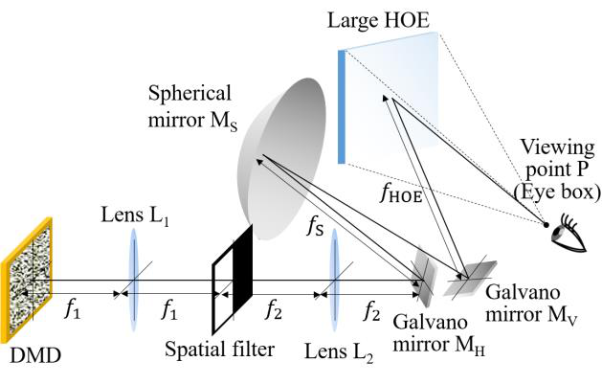
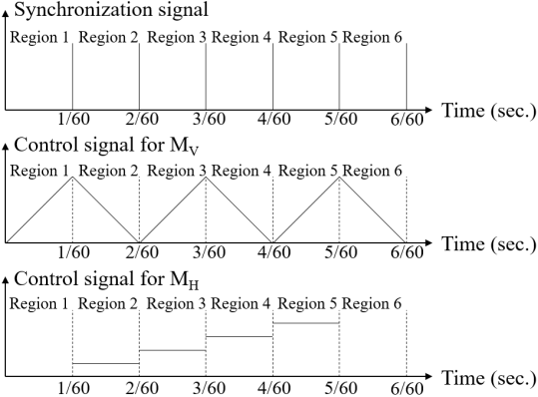
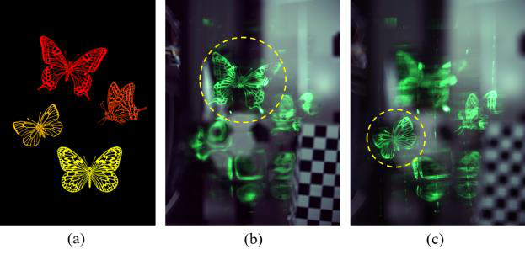
Very Wide FOV in Holographic AR Display Using a Large HOE Fabricated by Area Segmentation and Multiple Exposures
Yusuke Sando,Daisuke Barada,Toyohiko Yatagai Osaka Research Institute of Industrial Science and Technology, Japan,Center for Optical Research & Education, Utsunomiya University, Japan,Graduate School of Engineering, Utsunomiya University, Japan
Keywords : holographic 3D display,holographic optical element,very wide FOV,time division method,stretchable technology,Yusuke Sando,Osaka Research Institute of Industrial Science and Technology, Japan Organization: Osaka Research Institute of Industrial Science and Technology, Japan,Center for Optical Research & Education, Utsunomiya University, Japan,Graduate School of Engineering, Utsunomiya University, Japan
Keypoints : - Development of a large holographic optical element (HOE) using area segmentation and multiple exposures - Achievement of a very wide field of view (FOV) in an augmented reality (AR) 3D display - Utilization of the time division method to demonstrate a FOV of 34° horizontally and 25° vertically - Introduction of a large HOE to overcome FOV limitations caused by spherical aberration - Demonstration of holographic AR 3D display with a very wide FOV based on the time division method
Nycu MLlab

Slide 6
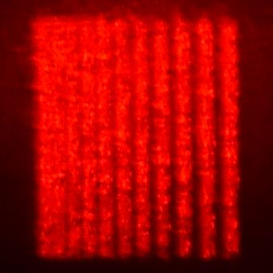
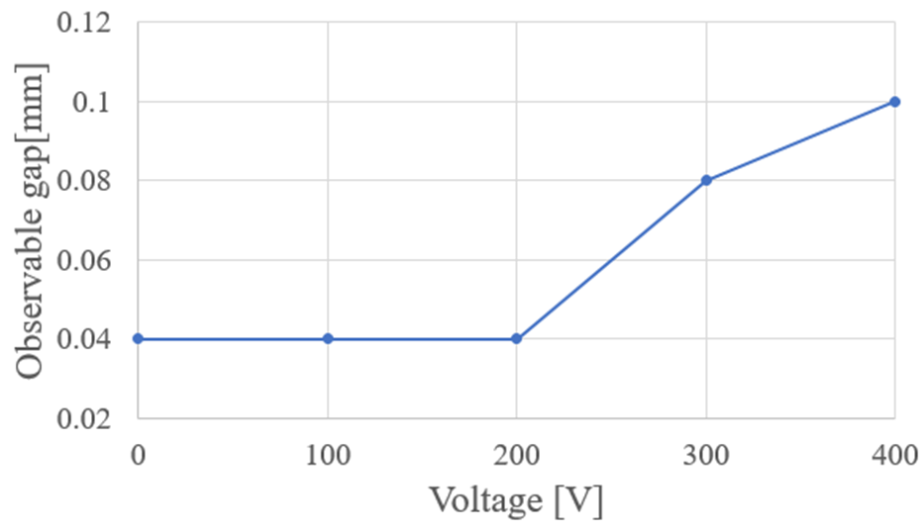
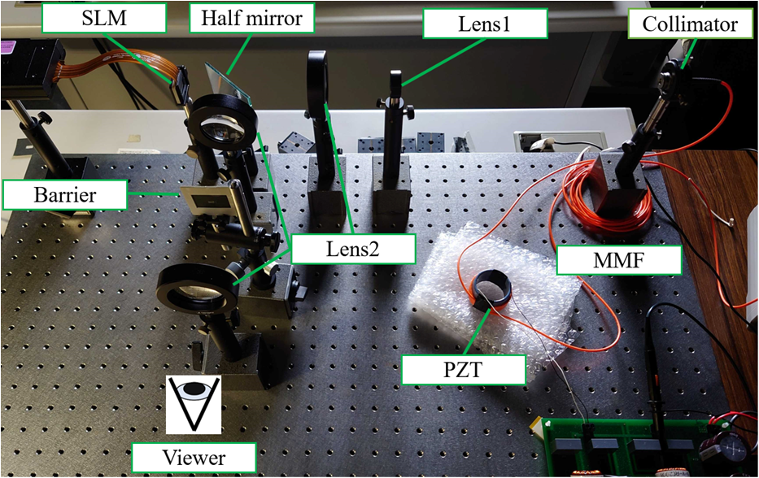
Controlling Speckle and Resolution of Reconstructed Images by Vibrating Multimode Optical Fiber with a Cylindrical Piezoelectric Transducer in Electro-Holography
Koki Matsuno,Yasuo Ito,Yuji Sakamoto Graduate School of Information Science and Technology, Hokkaido University, N-14 W-9, Kita-ku, Sapporo, Hokkaido, 060-0814, Japan
Keywords : Electro-holography,Speckle reduction,Multimode optical fiber,Piezoelectric transducer,Resolution control,Koki Matsuno,Graduate School of Information Science and Technology, Hokkaido University, N-14 W-9, Kita-ku, Sapporo, Hokkaido, 060-0814, Japan Organization: Graduate School of Information Science and Technology, Hokkaido University, N-14 W-9, Kita-ku, Sapporo, Hokkaido, 060-0814, Japan
Keypoints : - Development of a device to vibrate a multimode optical fiber using a cylindrical piezoelectric transducer for speckle reduction and resolution control in electro-holography - Importance of reducing speckle in electro-holography to enhance image quality - Discussion on methods to reduce speckle by lowering temporal and spatial coherence of laser light sources - Utilization of a Fresnel-type holography display system with a 4f optical system in the proposed device - Experiments demonstrating the effectiveness of the device in controlling speckle and resolution of reconstructed images
Nycu MLlab

Slide 7
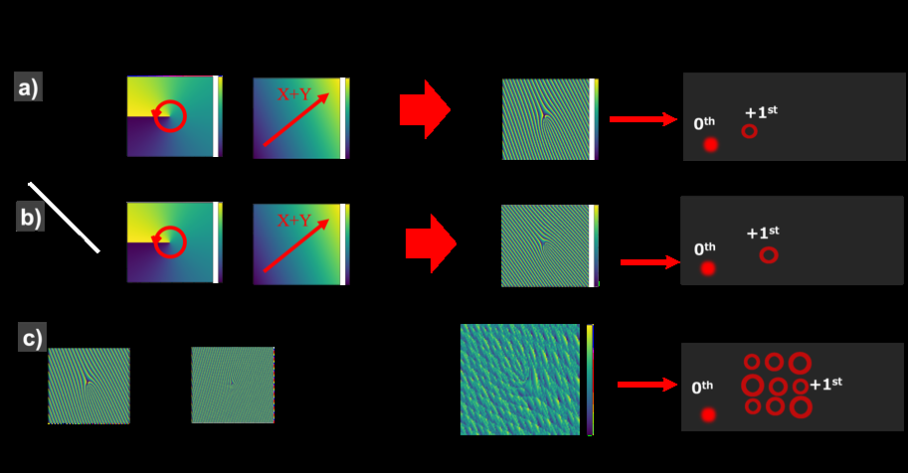
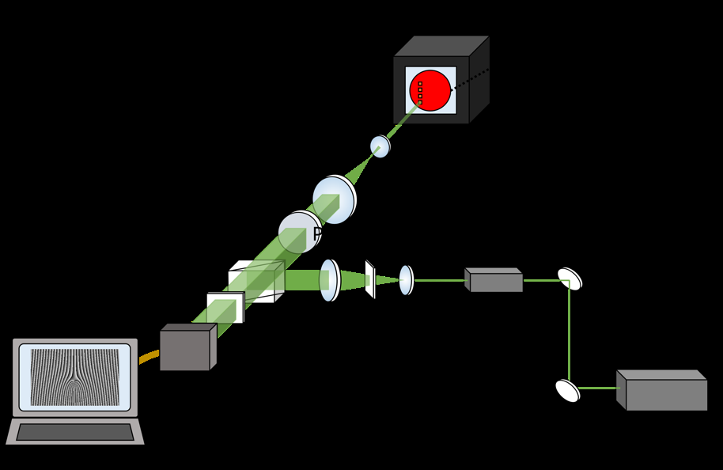
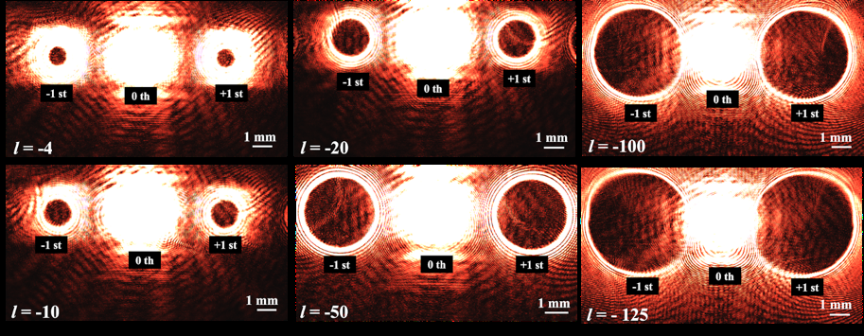
Digitally Printed Holograms for Efficient Generation of Structured Light
Boaz Jessie Jackin,Kenji Kinashi,Naoto Tsutsumi,Wataru Sakai Materials Innovation Laboratory, Kyoto Institute of Technology, Kyoto, Japan,Faculty of Material Science and Engineering, Kyoto Institute of Technology, Kyoto, Japan
Keywords : Computer Generated Holography,Structured Light,Digital Hologram Printing,Azo derivative azocarbazole,Optical Vortex Array,Boaz Jessie Jackin,Materials Innovation Laboratory, Kyoto Institute of Technology, Kyoto, Japan Organization: Materials Innovation Laboratory, Kyoto Institute of Technology, Kyoto, Japan,Faculty of Material Science and Engineering, Kyoto Institute of Technology, Kyoto, Japan
Keypoints : - Combining analog hologram recording material with digital hologram printing technique - Efficient generation of 100 vortex beams from a hologram of size 1mm x 1mm - Potential applications in optical communication and information processing - Advantages of digital holograms and analog holograms in laser beam shaping and structured light beam modes - Utilization of azo derivative azocarbazole for hologram recording material
Nycu MLlab

Slide 8

Holographic Image Reconstruction Using a Magneto-optical Spatial Light Modulator with its Pixel Pitch of 1µm and its Layout of 10k × 5k
Ken-ichi Aoshima,Nobuhiko Funabashi,Ryo Higashida,Mayumi Kawana,Yuta Yamaguchi,Kenji Machida Japan Broadcasting Corp., Science and Technology Research Laboratories, 1-10-11 Kinuta Setagaya Tokyo 157-8510, Japan
Keywords : holographic image reconstruction,magneto-optical spatial light modulator,pixel pitch,domain wall motion,viewing zone angle,Ken-ichi Aoshima,Japan Broadcasting Corp. Organization: Japan Broadcasting Corp., Science and Technology Research Laboratories, 1-10-11 Kinuta Setagaya Tokyo 157-8510, Japan
Keypoints : - Successful holographic image reconstruction using a magneto-optical spatial light modulator (MO-SLM) with a pixel pitch of 1μm. - MO-SLM's magnetization controlled by current-induced domain wall motion - enabling a large viewing zone angle of 30 degrees. - Fabricated MO-SLM device with a pixel layout of 10k × 5k and pixel pitch of 1μm horizontally and 4μm vertically. - Device structure includes two hard magnets (HMs) and a magnetic nanowire for light modulation. - MO-SLM operated by current-induced domain wall motion - modulating reflected light due to the magneto-optical effect of the Gd-Fe material.
Nycu MLlab

Slide 9
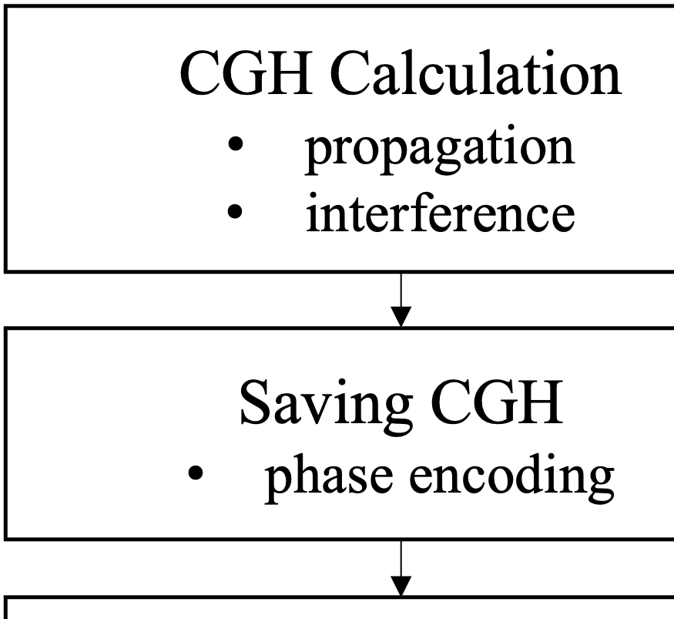

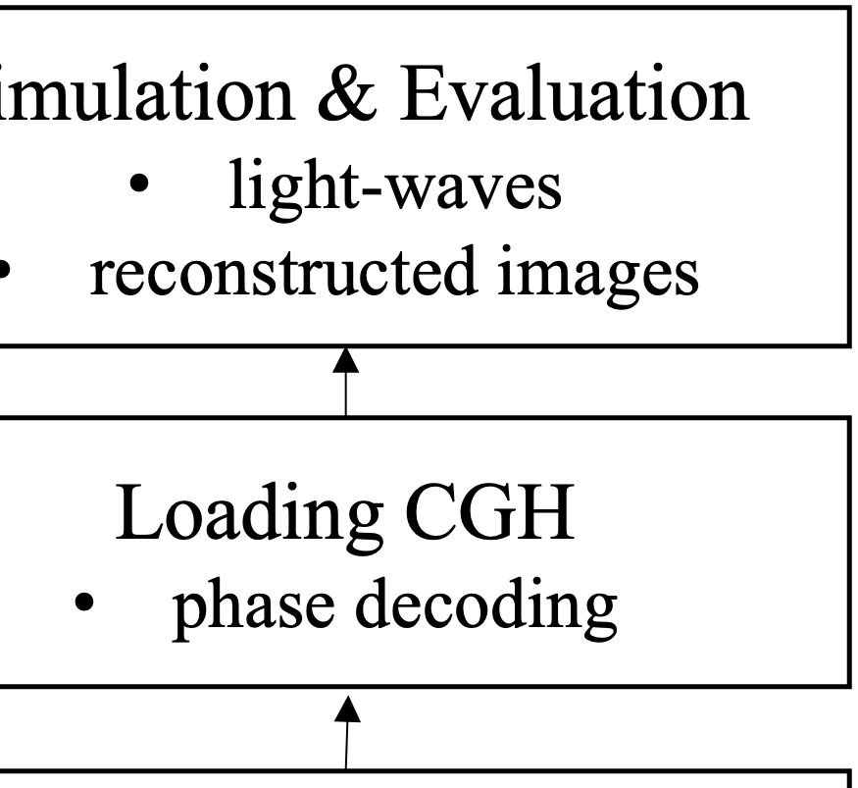
Evaluation of Simulated Image Quality for Wireless Transmission System of CGHs
Kazuhiro Yamaguchi,Misato Onishi,Yuji Sakamoto Suwa University of Science, Toyohira, Chino, Nagano, Japan,Graduate School of Information Science and Technology, Hokkaido University, Sapporo, Hokkaido, Japan
Keywords : micro-LED,stretchable displays,stretchable technology,Kazuhiro Yamaguchi,Suwa University of Science, Toyohira, Chino, Nagano, Japan Organization: Suwa University of Science, Toyohira, Chino, Nagano, Japan,Graduate School of Information Science and Technology, Hokkaido University, Sapporo, Hokkaido, Japan
Keypoints : - Development of 12-inch 100 PPI active-matrix micro-LED stretchable displays - Achievement of up to 20% stretchability in the displays - Integration of key technologies such as stretchable interconnect and stretchable film
Nycu MLlab

Slide 10
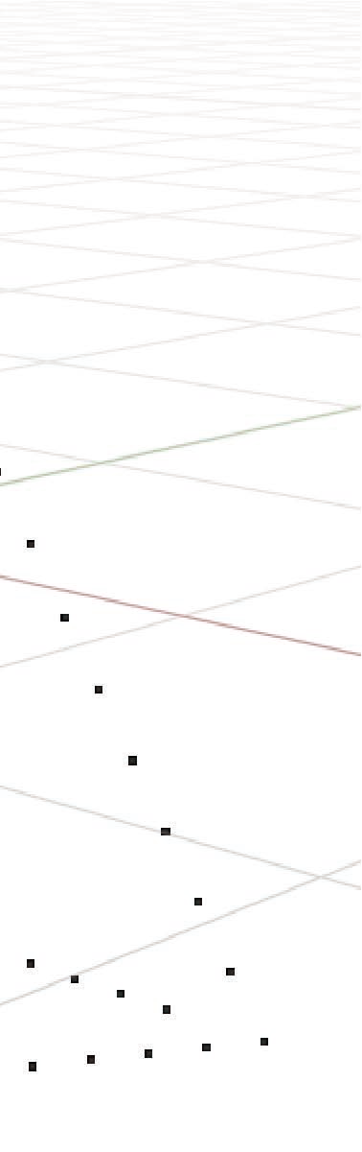
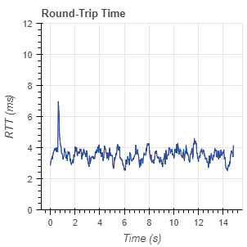
Performance Evaluation of Transmission System for Computer-Generated Holograms in Wired/Wireless Connections by Using Lossless Compression
Misato Onishi,Kazuhiro Yamaguchi,Yuji Sakamoto Suwa University of Science, Toyohira 5000-1, Chino, Nagano, 391-0292, Japan,Graduate School of Information Science and Technology, Hokkaido University, Kita 14, Nishi 9, Kita-ku, Sapporo, Hokkaido, 060-0814, Japan
Keywords : Computer-Generated Hologram,Electro-Holography,Transmission System,Image Quality,Compression Techniques,Misato Onishi,Suwa University of Science, Toyohira 5000-1, Chino, Nagano, 391-0292, Japan Organization: Suwa University of Science, Toyohira 5000-1, Chino, Nagano, 391-0292, Japan,Graduate School of Information Science and Technology, Hokkaido University, Kita 14, Nishi 9, Kita-ku, Sapporo, Hokkaido, 060-0814, Japan
Keypoints : - Development of a system for transmitting computer-generated holograms (CGHs) through a network for 3D object reconstruction using electro-holography - Evaluation of the quality of reconstructed objects and the performance of the transmission system - Highlighting holography as a 3D display technology enabling natural depth perception - Addressing challenges of transmitting CGHs and developing a system for streaming transmission and reconstruction - Comparison of transmission performance and image quality of reconstructed images in uncompressed/lossless compressed CGH movies streamed via wired/wireless connections
Nycu MLlab

Slide 11
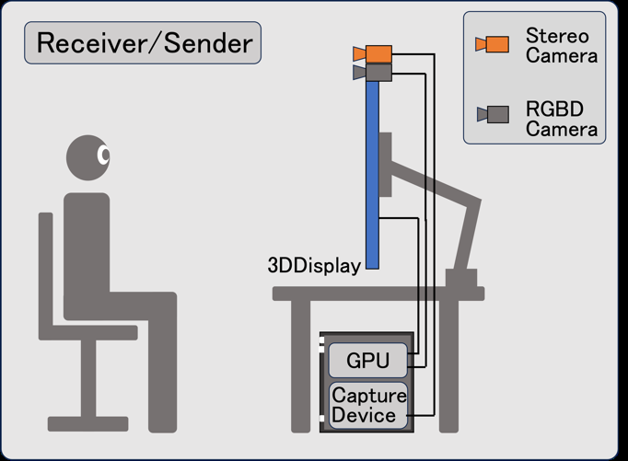
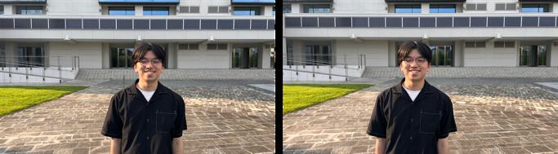
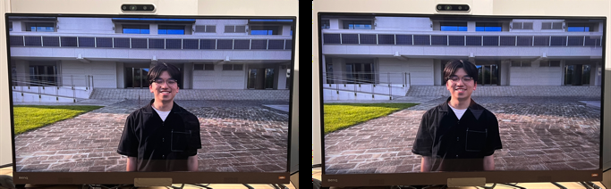
Real-time 3D Video Communication System using Stereo Video Capture and Autostereoscopic Display
Kyosuke Yanagida,Takafumi Koike,Goro Hamagishi,Hideya Takahashi Hosei University, Graduate School of Computer and Information Sciences, Tokyo, Japan,Osaka Metropolitan University, Graduate School of Engineering, Osaka, Japan,RealImage Inc., Tokyo, Japan
Keywords : autostereoscopic display,stereo cameras,real-time capture,3D videoconferencing,eye-tracking,Kyosuke Yanagida,Hosei University, Graduate School of Computer and Information Sciences, Tokyo, Japan Organization: Hosei University, Graduate School of Computer and Information Sciences, Tokyo, Japan,Osaka Metropolitan University, Graduate School of Engineering, Osaka, Japan,RealImage Inc., Tokyo, Japan
Keypoints : - Development of a high-quality real-time 3D video communication system - Utilization of stereo cameras and autostereoscopic 3D display - Evaluation through 2D videoconferences with multiple users - Simplified system configuration for minimized image processing - Assessment of system effectiveness as a video communication tool
Nycu MLlab

Slide 12
Increase in size of full-color stacked CGVH by tiling contact-copy
Shunsuke Fujiki,Hirohito Nishi,Kyoji Matsushima Department of Electrical, Electronic and Information Engineering, Kansai University, 3-3-35 Yamate-cho, Suita, Osaka 564-8680, Japan
Keywords : CGVH,computer-generated volume hologram,tiling contact-copy,full-color 3D images,high-quality holography,Shunsuke Fujiki,Department of Electrical, Electronic and Information Engineering, Kansai University, 3-3-35 Yamate-cho, Suita, Osaka 564-8680, Japan Organization: Department of Electrical, Electronic and Information Engineering, Kansai University, 3-3-35 Yamate-cho, Suita, Osaka 564-8680, Japan
Keypoints : - Novel technique for increasing the size of stacked CGVHs - Utilizes tiling contact-copy to extend size without increasing laser power - Demonstration of method with actual full-color stacked CGVHs - Promising approach to expanding size of CGVHs without high laser power - Enables production of high-quality full-color full-parallax 3D images
Nycu MLlab

Slide 13
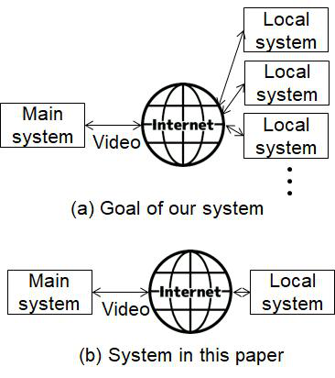
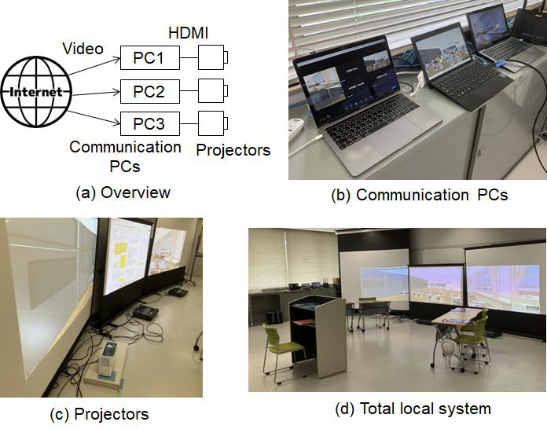
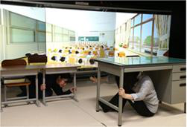
Emergency-drill Online Visual System to Build Ability against Unexpected Situations
Kyosuke Takahashi,Akua Kawakami,Masaki Umemoto,Kousuke Takahashi,Yuuya Sasai,Yasunori Terao,Kousuke Nakanishi,Naoto Nakayama,Yuuto Morishita,Akito Inoue,Shuto Ogura,Kenta Saito,Yuta Machigashira,Kotomi Nakanishi,Haruki Mizushina,Kenji Yamamoto,Hitoshi Inomo Kagawa University, 2217-20 Hayashi-cho, Takamatsu, 761-0396 Japan,Tokushima University, 2-1 Minamijousanzima, Tokushima, 770-8506 Japan
Keywords : emergency drill,visual system,online,school,disaster education,Kyosuke Takahashi,Kagawa University, 2217-20 Hayashi-cho, Takamatsu, 761-0396 Japan Organization: Kagawa University, 2217-20 Hayashi-cho, Takamatsu, 761-0396 Japan,Tokushima University, 2-1 Minamijousanzima, Tokushima, 770-8506 Japan
Keypoints : - Development of an emergency-drill system for building the ability to respond to unexpected situations - System involves main and local systems where trainees watch videos and make decisions based on scenarios - Aims to train individuals to respond quickly and flexibly to unexpected situations - Online system connects Kagawa University and Tokushima University for training - System design allows for flexibility and scalability for widespread adoption
Nycu MLlab

Slide 14
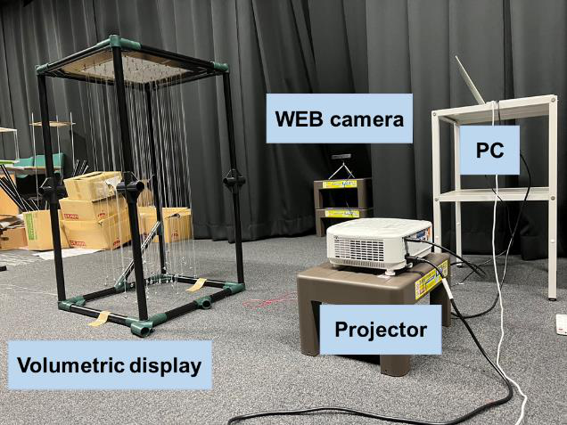
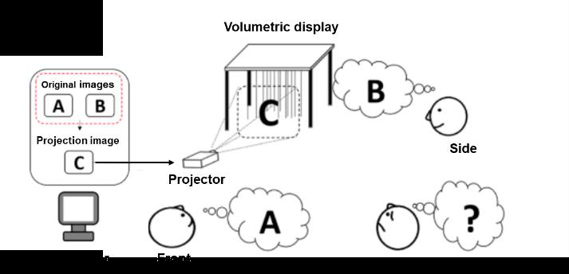
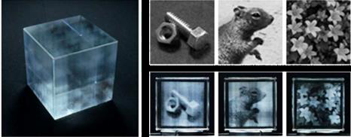
Height Adjustment of Directional Volumetric Displays Using Deep Learning
Yuta Fukumoto,Takashi Nishitsuji,Naoto Hoshikawa,Hirotaka Nakayama,Tomoyoshi Shimobaba,Tomoyoshi Ito,Atsushi Shiraki Graduate School of Engineering, Chiba University, Japan,Faculty of Science, Toho University, Japan,Graduate School of Science and Technology, University of Tsukuba, Japan,Center for Computational Astrophysics, National Astronomical Observatory of Japan, Japan
Keywords : volumetric display,directional image,deep learning,media art,Convolutional Neural Networks (CNN),Yuta Fukumoto,Graduate School of Engineering, Chiba University, Japan Organization: Graduate School of Engineering, Chiba University, Japan,Faculty of Science, Toho University, Japan,Graduate School of Science and Technology, University of Tsukuba, Japan,Center for Computational Astrophysics, National Astronomical Observatory of Japan, Japan
Keypoints : - Development of directional volumetric display with deep learning for height adjustment - Displaying different two-dimensional information in multiple directions - Application in media art and security fields - Utilizing Convolutional Neural Networks (CNN) for accurate height adjustment - Future plans to improve image quality and model performance for 16x16 display
Nycu MLlab

Slide 15
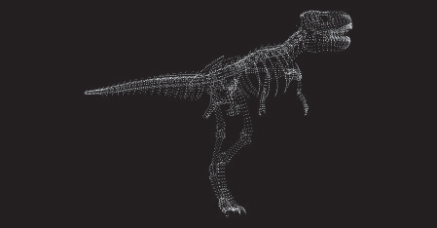
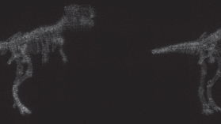
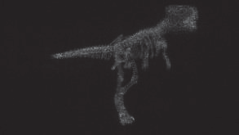
Simplified Wide Viewing Angle Electronic Holography Using a Checkered Hologram Generated by a Lens Array
Soma Fujimori,Tomoyoshi Ito,Tomoyoshi Shimobaba Graduate School of Engineering, Chiba University, 1-33 Yayoi-cho, Inage-ku, Chiba 263-8522, Japan
Keywords : electronic holography,viewing angle,lens array,checkered hologram,misalignment,Soma Fujimori,Graduate School of Engineering, Chiba University, 1-33 Yayoi-cho, Inage-ku, Chiba 263-8522, Japan Organization: Graduate School of Engineering, Chiba University, 1-33 Yayoi-cho, Inage-ku, Chiba 263-8522, Japan
Keypoints : - Development of wide viewing angle electronic holography using a checkered hologram generated by a lens array - Method offers simplicity in the optical system and robustness to misalignment - Lens array-based method to enhance viewing angles in electronic holography - Demonstrated method can produce reconstructed images with wide viewing angles - Proposed method is robust to misalignment and allows for adjustment while viewing
Nycu MLlab

Slide 16
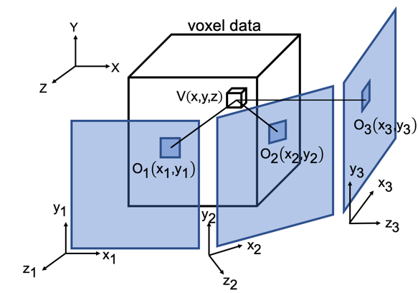
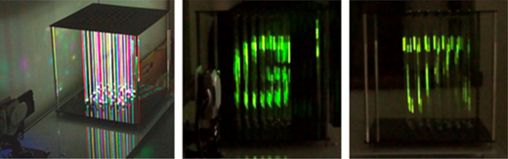
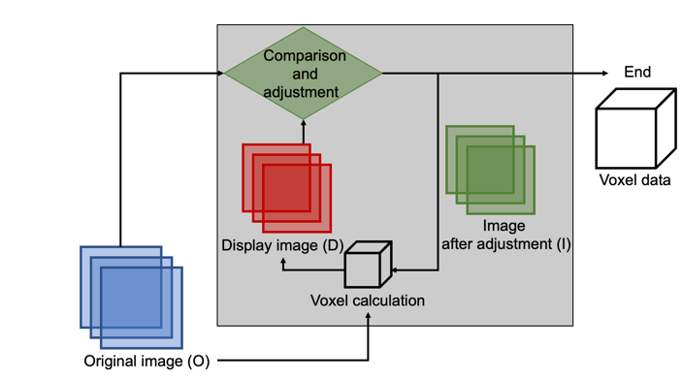
Expanding the Viewable Area of Directional Volumetric Displays
Kazuki Kamizuru,Takashi Nishitsuji,Naoto Hoshikawa,Hirotaka Nakayama,Tomoyoshi Ito,Tomoyoshi Shimobaba,Atsushi Shiraki 1 Graduate School of Engineering, Chiba University, 1-33 Yayoi-cho, Inage-ku, Chiba 263-8522, Japan,2 Faculty of Science, Toho University, 2-2-1 Miyama, Funabashi-shi, Chiba 274-8510, Japan,3 Graduate School of Science and Technology, University of Tsukuba, 1-1-1 Tennodai, Tsukuba-shi, Ibaraki 305-8577, Japan,4 Center for Computational Astrophysics, National Astronomical Observatory of Japan, 2-21-1 Osawa, Mitaka, Tokyo 181-8588, Japan
Keywords : volumetric display,directional display,string,voxel calculation,image quality improvement,Kazuki Kamizuru,1 Graduate School of Engineering, Chiba University, 1-33 Yayoi-cho, Inage-ku, Chiba 263-8522, Japan Organization: 1 Graduate School of Engineering, Chiba University, 1-33 Yayoi-cho, Inage-ku, Chiba 263-8522, Japan,2 Faculty of Science, Toho University, 2-2-1 Miyama, Funabashi-shi, Chiba 274-8510, Japan,3 Graduate School of Science and Technology, University of Tsukuba, 1-1-1 Tennodai, Tsukuba-shi, Ibaraki 305-8577, Japan,4 Center for Computational Astrophysics, National Astronomical Observatory of Japan, 2-21-1 Osawa, Mitaka, Tokyo 181-8588, Japan
Keypoints : - Development of directional volumetric displays using strings and projectors - Focus on expanding the viewable area in the vertical direction - Importance of 3D and volumetric displays for immersive viewing experiences - Challenges in aligning observed results with the original image - Enhancement of voxel calculation algorithms and image quality improvement techniques
Nycu MLlab

Slide 17
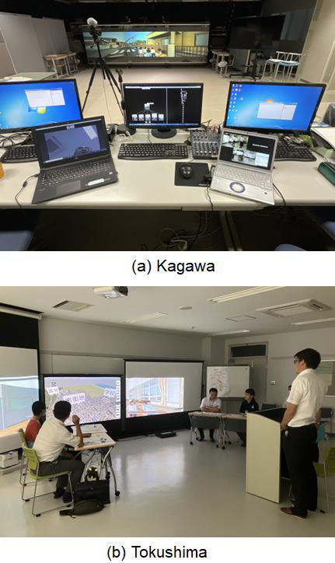
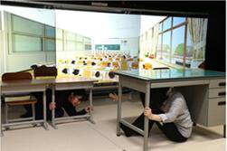
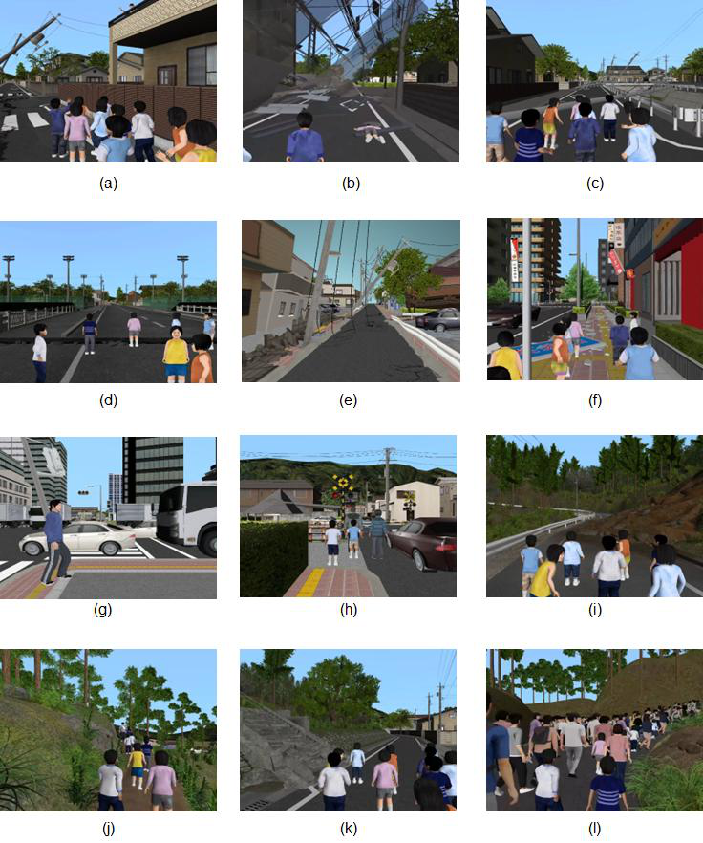
Emergency-drill Scenarios to Build Ability against Unexpected Situations on Tsunami
Kenji Yamamoto,Masaki Umemoto,Akua Kawakami,Kousuke Takahashi,Yuuya Sasai,Yasunori Terao,Kousuke Nakanishi,Naoto Nakayama,Yuuto Morishita,Akito Inoue,Shuto Ogura,Kenta Saito,Yuta Machigashira,Kotomi Nakanishi,Kyosuke Takahashi,Hitoshi Inomo,Haruki Mizushina Tokushima University, 2-1 Minamijousanzima, Tokushima, 770-8506 Japan,Kagawa University, 2217-20 Hayashi-cho, Takamatsu, 761-0396 Japan
Keywords : emergency drill,scenario,visual system,disaster education,tsunamis,Kenji Yamamoto,Tokushima University, 2-1 Minamijousanzima, Tokushima, 770-8506 Japan Organization: Tokushima University, 2-1 Minamijousanzima, Tokushima, 770-8506 Japan,Kagawa University, 2217-20 Hayashi-cho, Takamatsu, 761-0396 Japan
Keypoints : - Development of scenarios to build the ability to respond to unexpected situations between giant earthquakes and tsunamis - Exploration of areas where tsunamis are expected to identify potential post-earthquake scenarios - Utilization of scenarios in a training system developed by the authors - Focus on training individuals to respond quickly and flexibly to unexpected situations - Preparation of scenarios related to tsunamis and actions between giant earthquakes and tsunamis
Nycu MLlab

Slide 18
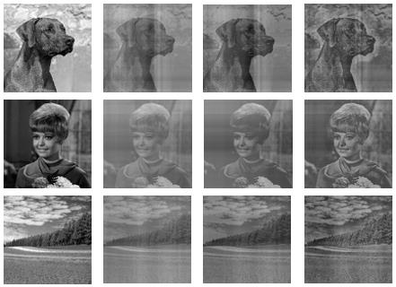
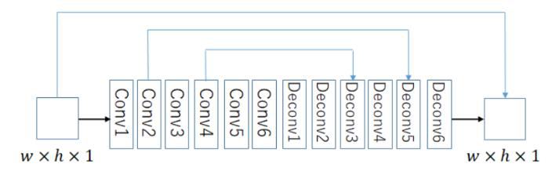
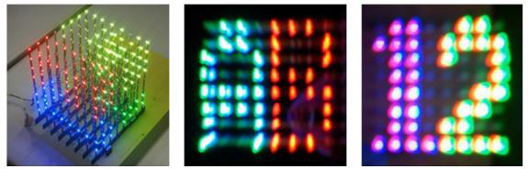
Enhancing Image Quality in Directional Volumetric Displays with Red-Net
Seigou Takeshita,Takashi Nishitsuji,Naoto Hoshikawa,Hirotaka Nakayama,Tomoyoshi Shimobaba,Tomoyoshi Ito,Atsushi Shiraki Graduate School of Engineering, Chiba University, Japan,Faculty of Science, Toho University, Japan,Graduate School of Science and Technology, University of Tsukuba, Japan,Center for Computational Astrophysics, National Astronomical Observatory of Japan, Japan
Keywords : micro-LED,stretchable displays,stretchable technology,Seigou Takeshita,Graduate School of Engineering, Chiba University, Japan Organization: Graduate School of Engineering, Chiba University, Japan,Faculty of Science, Toho University, Japan,Graduate School of Science and Technology, University of Tsukuba, Japan,Center for Computational Astrophysics, National Astronomical Observatory of Japan, Japan
Keypoints : - Development of 12-inch 100 PPI active-matrix micro-LED stretchable displays - Achievement of up to 20% stretchability in the displays - Integration of key technologies like stretchable interconnect and stretchable film
Nycu MLlab

Slide 19
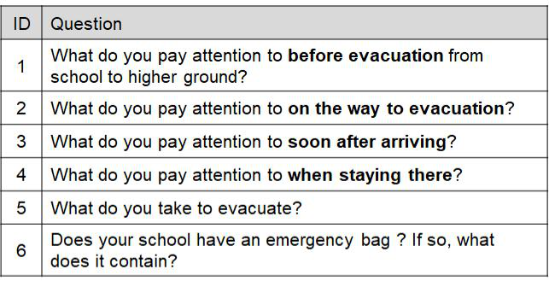
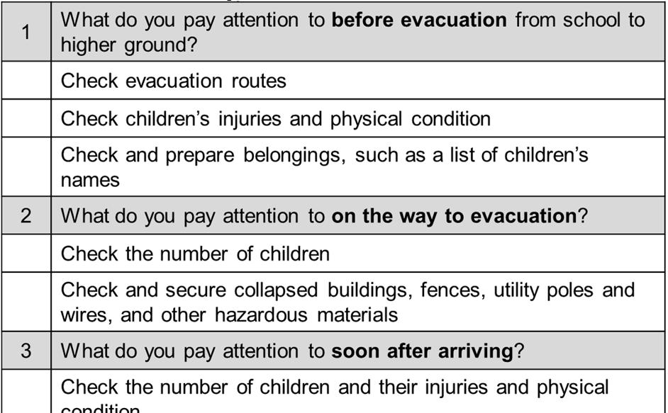
Emergency Drill Using Online Visual System
Hitoshi Inomo,Akua Kawakami,Masaki Umemoto,Kousuke Takahashi,Yuuya Sasai,Yasunori Terao,Kousuke Nakanishi,Naoto Nakayama,Yuuto Morishita,Akito Inoue,Shuto Ogura,Kenta Saito,Yuta Machigashira,Kotomi Nakanishi,Kyosuke Takahashi,Haruki Mizushina,Kenji Yamamoto Kagawa University, 2217-20 Hayashi-cho, Takamatsu, 761-0396 Japan,Tokushima University, 2-1 Minamijousanzima, Tokushima, 770-8506 Japan
Keywords : emergency drill,online visual system,disaster training,flexible scenario changes,evacuation simulation,Hitoshi Inomo,Kagawa University, 2217-20 Hayashi-cho, Takamatsu, 761-0396 Japan Organization: Kagawa University, 2217-20 Hayashi-cho, Takamatsu, 761-0396 Japan,Tokushima University, 2-1 Minamijousanzima, Tokushima, 770-8506 Japan
Keypoints : - Development of emergency drill using online visual system - Training individuals to respond quickly to unforeseen events - Conducting drill at Tokushima University with teachers from primary and junior high schools - Utilizing an online visual system for disaster training - Effective simulation of dilemmas faced during evacuations
Nycu MLlab

Slide 20
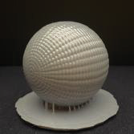
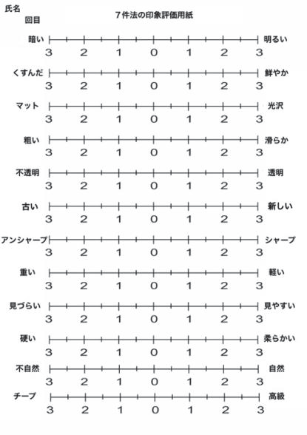
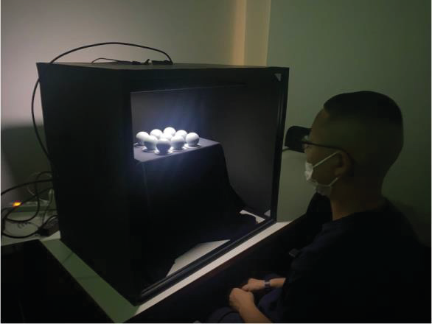
Influence of Material Appearance on Perception in Dyslexia
Takashi Yamazoe,Hanae Ikeshita 1Faculty of Science and Engineering, Seikei University, Japan,2Faculty of Arts and Sciences, Department of Information and Media Studies, Sagami Women's University, Japan
Keywords : micro-LED,stretchable displays,material appearance,dyslexia,spatial cognition,Takashi Yamazoe,1Faculty of Science and Engineering, Seikei University, Japan Organization: 1Faculty of Science and Engineering, Seikei University, Japan,2Faculty of Arts and Sciences, Department of Information and Media Studies, Sagami Women's University, Japan
Keypoints : - Development of 12-inch 100 PPI active-matrix micro-LED stretchable displays - Achievement of up to 20% stretchability in the displays - Integration of key technologies like stretchable interconnect - stretchable film - and micro-LED
Nycu MLlab

Slide 21
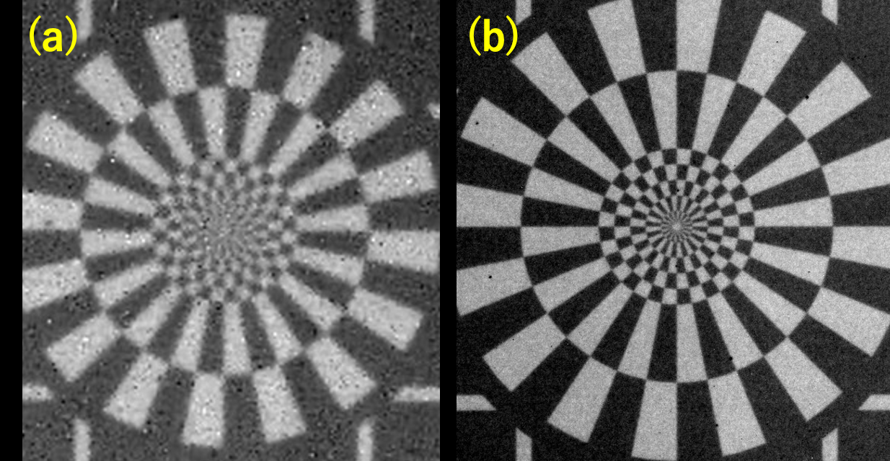
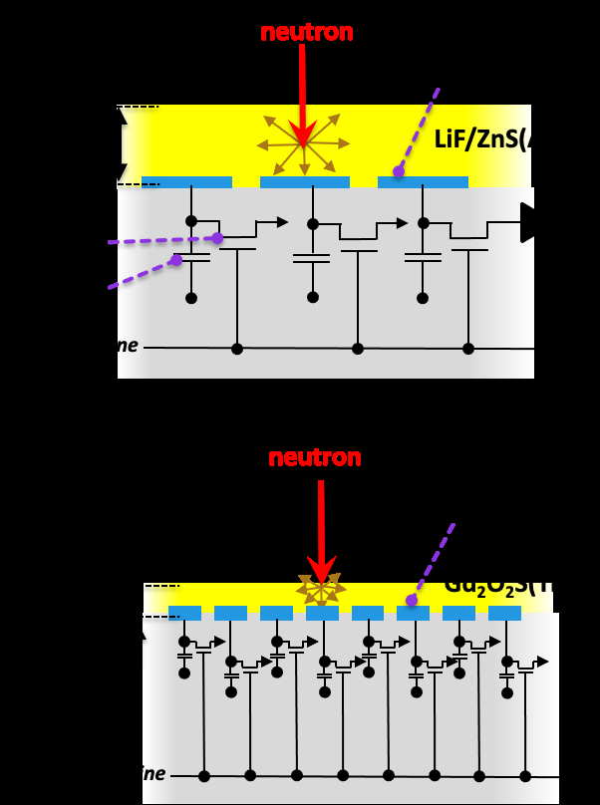
Neutron Imaging Performance at AIST: Insights into Current Status with Neutron Flat-Panel-Detector and IGZO-TFT
Takeshi Fujiwara,Koichi Kino,Masahito Tanaka,Hiromi Kimura,Nagayasu Oshima National Metrology Institute of Japan, National Institute of Advanced Industrial Science and Technology (AIST), Tsukuba, Ibaraki 305-8568, Japan
Keywords : micro-LED,stretchable displays,stretchable technology,Takeshi Fujiwara,National Metrology Institute of Japan, National Institute of Advanced Industrial Science and Technology (AIST), Tsukuba, Ibaraki 305-8568, Japan Organization: National Metrology Institute of Japan, National Institute of Advanced Industrial Science and Technology (AIST), Tsukuba, Ibaraki 305-8568, Japan
Keypoints : - Development of 12-inch 100 PPI active-matrix micro-LED stretchable displays - Achievement of up to 20% stretchability in the displays - Integration of key technologies such as stretchable interconnect - stretchable film - and micro-LED
Nycu MLlab

Slide 22
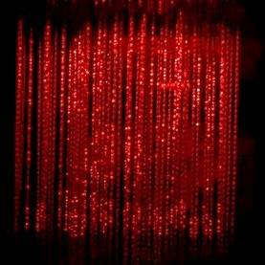
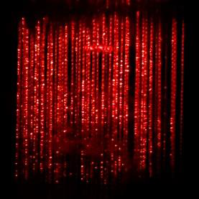

Proposal of an 8×8 Holographic Directional Volumetric Display
Tomoya Isayama,Takashi Nishitsuji,Naoto Hoshikawa,Hirotaka Nakayama,Tomoyoshi Shimobaba,Tomoyoshi Ito,Atsushi Shiraki Graduate School of Engineering, Chiba University, Japan,Faculty of Science, Toho University, Japan,Graduate School of Science and Technology, University of Tsukuba, Japan,Center for Computational Astrophysics, National Astronomical Observatory of Japan, Japan
Keywords : Volumetric display,Directional image,Electronic holography,Tomoya Isayama,Graduate School of Engineering, Chiba University, Japan Organization: Graduate School of Engineering, Chiba University, Japan,Faculty of Science, Toho University, Japan,Graduate School of Science and Technology, University of Tsukuba, Japan,Center for Computational Astrophysics, National Astronomical Observatory of Japan, Japan
Keypoints : - Development of an 8x8 holographic directional volumetric display - Utilization of electronic holography for observing directional images from front and side - Confirmation of ability to observe different holographic reconstruction images from both directions - Use of volumetric display with threads for diffusing light from projection - Potential for new applications in information display
Nycu MLlab

Slide 23



Two Types of Correlation between Donor-level and Concentration in a-IGZO
Hanjun Cho,Masatake Tsuji,Junghwan Kim,Hideo Hosono MDX Research Center for Element Strategy, International Research Frontiers Initiative, Tokyo Institute of Technology, Yokohama 226-8503, Japan,Graduate school of Semiconductor Materials and Devices Engineering, Ulsan National Institute of Science and Technology (UNIST), Ulsan 44919, Republic of Korea,National Institute for Materials Science (NIMS), Tsukuba, Ibaraki 305-0044, Japan
Keywords : amorphous oxide semiconductor,carrier concentration,activation energy,Hall effect,flat-panel display,Hanjun Cho,MDX Research Center for Element Strategy, International Research Frontiers Initiative, Tokyo Institute of Technology, Yokohama 226-8503, Japan Organization: MDX Research Center for Element Strategy, International Research Frontiers Initiative, Tokyo Institute of Technology, Yokohama 226-8503, Japan,Graduate school of Semiconductor Materials and Devices Engineering, Ulsan National Institute of Science and Technology (UNIST), Ulsan 44919, Republic of Korea,National Institute for Materials Science (NIMS), Tsukuba, Ibaraki 305-0044, Japan
Keypoints : - Investigation of correlation between carrier concentration and activation energy in a-IGZO semiconductors - Observation of positive and negative correlations for film thickness and post-annealing process in a-IGZO - Experimental methods included Hall effects - RF magnetron sputtering - AC field temperature dependence Hall effect measurement - and HAXPES - Study aims to understand carrier generation mechanism in a-IGZO for flat-panel display industry - Focus on Indium-Gallium-Zinc-Oxide (a-IGZO) as an amorphous oxide semiconductor
Nycu MLlab

Slide 24



High Mobility Oxide TFT Using Poly-Crystalline Oxide Semiconductor on Gen.6 Glass Substrate
Masashi Tsubuku,Hajime Watakabe,Toshinari Sasaki,Takaya Tamaru,Marina Mochizuki,Hiroyuki Kimura,Emi Kawashima,Daichi Sasaki,Yuki Tsuruma Japan Display Inc., Chiba, Japan,Idemitsu Kosan Co., Ltd., Chiba, Japan
Keywords : Oxide TFTs,Poly-crystalline oxide semiconductor,Low power consumption,OLED display,Gen.6 glass substrates,Masashi Tsubuku,Japan Display Inc., Chiba, Japan Organization: Japan Display Inc., Chiba, Japan,Idemitsu Kosan Co., Ltd., Chiba, Japan
Keypoints : - Development of stable poly-crystalline oxide semiconductor (Poly-OS) for TFT channels on Gen.6 glass substrates - Improvement in mobility and stability of TFTs - Achieving low off-state current similar to conventional oxide TFTs - High on-state current equivalent to LTPS TFTs benefiting low power consumption devices - Successful fabrication of Poly-OS TFT on Gen.6 glass substrates with over 5 times improvement in field effect mobility
Nycu MLlab

Slide 25



513-ppi OLED Display Using Vertical Oxide Semiconductor Transistor
Motoharu Saito,Hideaki Shishido,Susumu Kawashima,Shingo Eguchi,Chieko Misawa,Hidenori Mori,Emi Koezuka,Masataka Nakada,Yukinori Shima,Koji Kusunoki,Kenichi Okazaki,Junichi Koezuka,Norihiko Seo,Shunpei Yamazaki Semiconductor Energy Laboratory Co., Ltd., Kanagawa, Japan,Semiconductor Energy Laboratory Co., Ltd., Tochigi, Japan
Keywords : CAAC-IGZO,OLED,High resolution,Vertical structure,RGB stripe,Motoharu Saito,Semiconductor Energy Laboratory Co., Ltd., Kanagawa, Japan Organization: Semiconductor Energy Laboratory Co., Ltd., Kanagawa, Japan,Semiconductor Energy Laboratory Co., Ltd., Tochigi, Japan
Keypoints : - Development of a vertical oxide semiconductor transistor (VFET) for a 513-ppi OLED display - RGB stripe arrangement and internal compensation pixel circuit implemented in the display - VFET offers simpler fabrication process compared to LTPO FET - Enables low-power and high-resolution displays - Research demonstrates potential of VFETs for high-resolution OLED displays
Nycu MLlab

Slide 26


Four-Terminal Poly-Si Vertical TFTs on Glass Substrates
Kosei Suzuki,Kotaro Kusunoki,Akito Hara Graduate School of Engineering, Tohoku Gakuin University, 3-1 Simizukoji, Wakabayasi-ku, Sendai, Miyagi, 984-0075, JAPAN
Keywords : TFT,vertical TFT,poly-Si,four terminals,display technology,Kosei Suzuki,Graduate School of Engineering, Tohoku Gakuin University, 3-1 Simizukoji, Wakabayasi-ku, Sendai, Miyagi, 984-0075, JAPAN Organization: Graduate School of Engineering, Tohoku Gakuin University, 3-1 Simizukoji, Wakabayasi-ku, Sendai, Miyagi, 984-0075, JAPAN
Keypoints : - Fabrication of n-ch four-terminal poly-Si vertical TFTs on glass substrates - Poly-Si crystallized by metal-induced crystallization - Double gate drive showed superior performance compared to single gate drive - 4T structure proved effective in enhancing VTFT performance - Promising results for future applications in display technology
Nycu MLlab

Slide 27


CMOS Based on Self-Aligned Cu-MIC Double-Gate Poly-Ge TFT on Glass Substrates
Sho Suzuki,Akito Hara Graduate School of Engineering, Tohoku Gakuin University, 3-1 Simizukoji, Wakabayasi-ku, Sendai, Miyagi 984-0075, Japan
Keywords : CMOS,Poly-Ge,Cu-MIC,TFT,crystalline quality,Sho Suzuki,Graduate School of Engineering, Tohoku Gakuin University, 3-1 Simizukoji, Wakabayasi-ku, Sendai, Miyagi 984-0075, Japan Organization: Graduate School of Engineering, Tohoku Gakuin University, 3-1 Simizukoji, Wakabayasi-ku, Sendai, Miyagi 984-0075, Japan
Keypoints : - Fabrication of CMOS circuits on glass substrates using self-aligned double-gate poly-Ge TFTs through Cu-MIC at 500 ºC - Creation of a CMOS inverter by connecting n- and p-channel TFTs - Ge is a potential channel material for CMOS circuits on glass substrates due to its higher mobility and lower melting point compared to Si - Poly-Ge TFTs with high crystalline quality have been fabricated through various techniques - Evaluation of crystal quality using Micro-Raman scattering
Nycu MLlab

